Slide 1
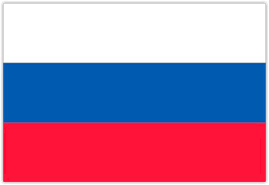
In the name of god
MY name is armin gharachorloo
My techer name is MR.JAVADI
WE WANT TO LEARN ABOUT RUSSIA

Slide 2
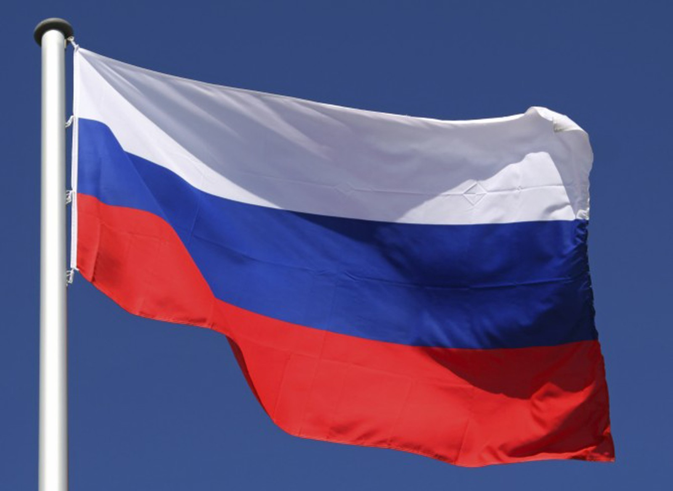
FLAG OF RUSSIA

Slide 3
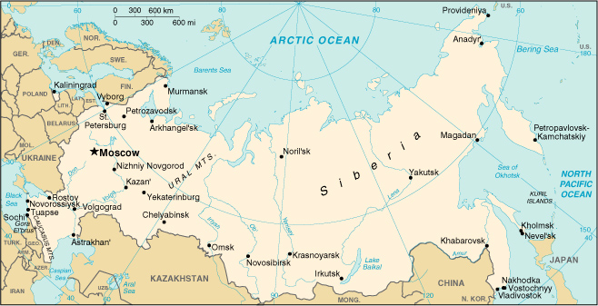
location

Slide 4
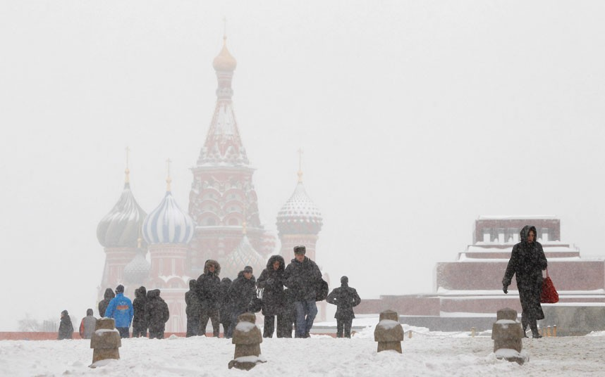
Weather in russia

Slide 5
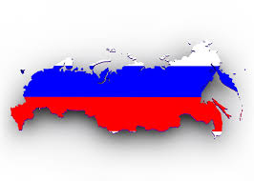
Intresting facts about russia

Slide 6
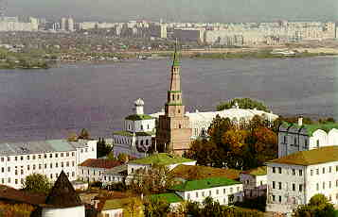
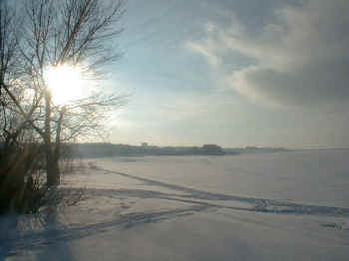
KAZAN

Slide 7
EARLY 16TH CENTURY
(IVAN THE TERRIBLE- 1547-1584)

Slide 8
END OF THE 17TH CENTURY
(PETER THE GREAT- 1682-1725)

Slide 9
EARLY 20TH CENTURY

Slide 10
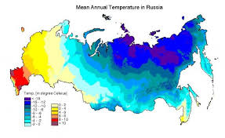
CLIMATOLOGY

Slide 11
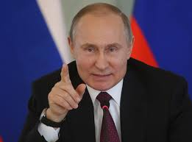
PRESIDENT OF RUSSIA:Vladimir Putin

Slide 12
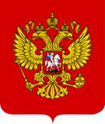

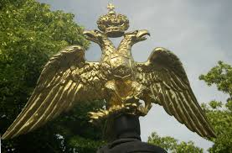
ARM OF RUSSIA

Slide 13
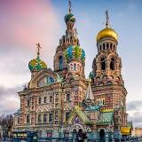
Saint Petersburg

Slide 14
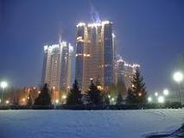
SAMARA

Slide 15
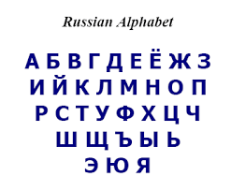

Slide 16
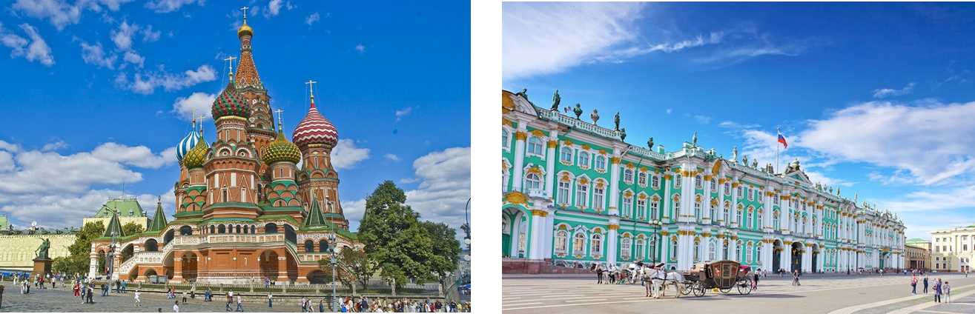

Slide 17
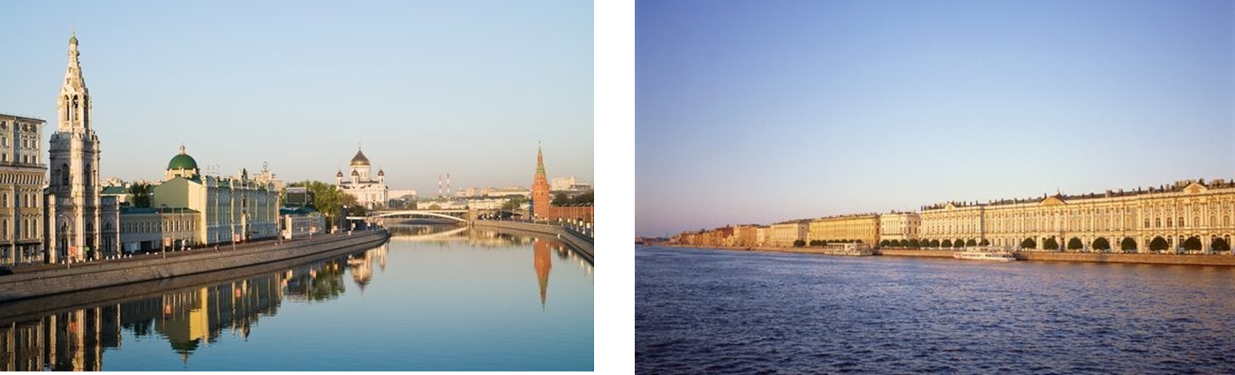

Slide 18
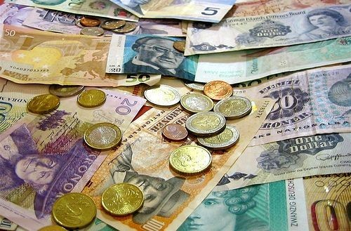

Slide 19
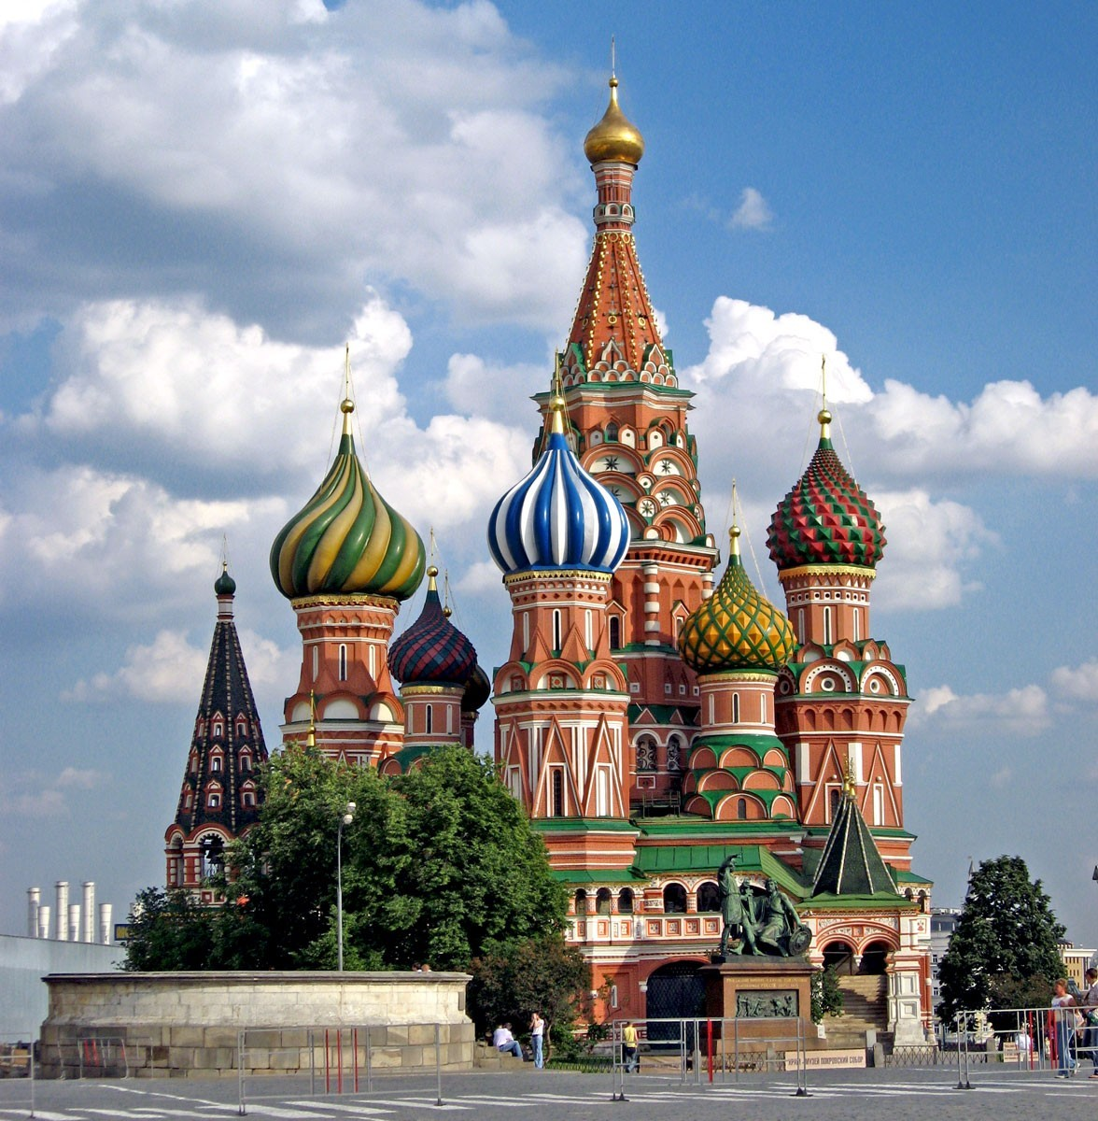
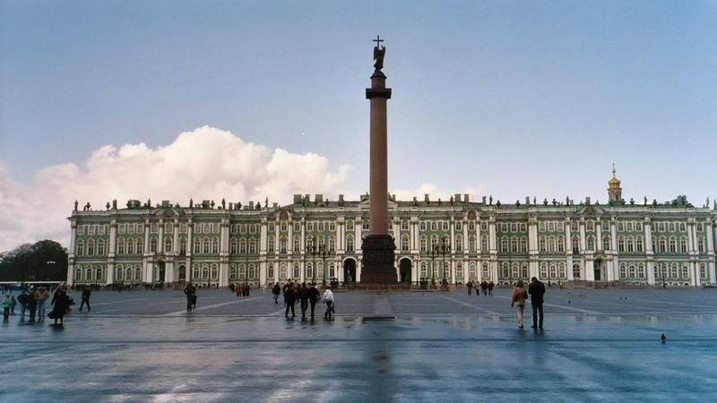
CAPITAL OF RUSSIA IS MOSCOW

Slide 20
Thank You For Your Attention

